Slide 1
Native Plants of Howard County, MD
Using Them to Attract Wildlife to Your Yard

Slide 2
Using Native Plants
It’s now easier to use native plants in your garden. There is a wealth of information available on which plants are native and their benefits on the local ecology.
I have complied a list of my favorite natives, most of which are native to the Maryland Piedmont. A few are favorites that are native to the Eastern US, Northeastern US or Southeastern US- they are all from close locations and are the most beneficial for our local wildlife.

Slide 3
Native Plant Selection
It can be tricky to find a large selection of locally native plants at local nurseries. I have made this presentation to cover the plants we have had success using locally and that you can also purchase locally.
It is ideal to purchase plants that have been grown locally and have not been harvested from the wild

Slide 4
Native Plant Selection
There is an accompanying chart that I created that is available on our website www.laurensgardenservice.com. It is called Native Plants of Howard County and gives all the information you need to find the right plant for your property. It includes information on which wildlife the plants benefit and which terrible conditions the plants will tolerate. There is also a lot of other great information on gardening, rain gardens and using natives that is all information from our experience gardening in Howard County, MD and the surrounding areas.

Slide 5
Native Plant Selection

Slide 6
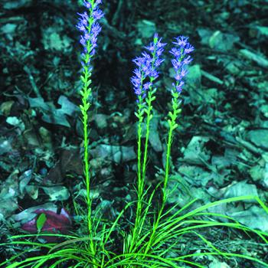
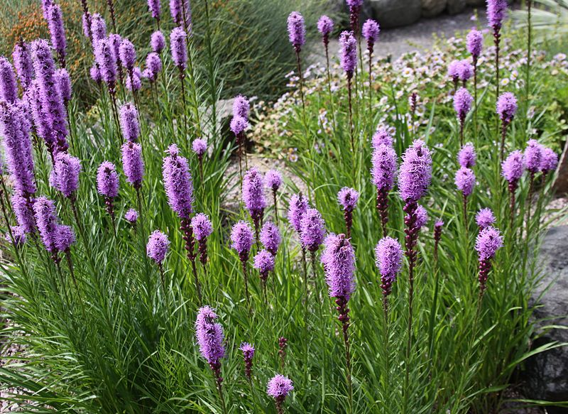
Native Plant Selection
The list I have created also includes the correct species of plants. Some sellers list a genus of plant, which may have another species that is actually native. Example- Liatris graminifolia is a locally native plant. Catalogs list ‘Liatris’ under their native section but they actually have Liatris spicata which is not a locally native species. In this case Liatris spicata is of good benefit to local wildlife and the locally native Liatris graminifolia is tough to find in commerce.
Liatris graminifolia
Liatris spicata

Slide 7
Attracting Wildlife to Your Yard
1. Plant a variety of locally native plants
Some plants are marketed as native but aren’t locally native
It’s ok to sprinkle in some plants that are not locally native, just know that they haven’t coevolved with the local flora and fauna so may not be of as much value as a local native would be.
In a case where a local native is not readily available in commerce I will substitute with a genus that is similar and grows in the East, Northeast or Southeast US

Slide 8
Attracting Wildlife to Your Yard
Use mostly regular natives, with a few ‘cultivars’ sprinkled in
A cultivar is a plant that has been produced in cultivation, by selective breeding, to demonstrate desirable characteristics like flower showiness, foliage variations or flower color variations to name a few. Plants are now being selected and cultivated to grow more compactly, resist pests and diseases, tolerate adverse weather conditions like heat and humidity, cold tolerance, drought tolerance, etc.

Slide 9
Cultivars
A cultivar is a plant that has been produced in cultivation, by selective breeding, to demonstrate desirable characteristics like flower showiness, foliage variations or flower color variations to name a few. Plants are now being selected and cultivated to grow more compactly, resist pests and diseases, tolerate adverse weather conditions like heat and humidity, cold tolerance, drought tolerance, etc.

Slide 10
Cultivars
There is some debate as to whether the introduction of numerous cultivars is beneficial to wildlife. For example, it has been observed that butterflies and pollinators do not visit Echinacea varieties nearly as much as the original plants.
Some argue that cultivars with showier flowers are easier to find for pollinators then their original counterparts
As of now not much research has been gathered. I believe keeping it as close to the way nature intended it makes the most sense. I do use cultivars and varieties, I just make sure I use more of the truly native plants.

Slide 11
Variety
A plant Variety is a cultivar that is protected legally by the original grower.
Often the 2 are use interchangeably incorrectly. A grape ‘variety’ is actually a cultivar.

Slide 12
Attracting Wildlife to Your Yard
2. Plant a mix of grasses, ferns, groundcovers, trees, shrubs and perennials, planted densely.
Creating a mixture of heights and different types of plants will attract the widest range of wildlife.
Use at least 3 of each for perennials, ferns, grasses and shrubs. Start with 5 of each of the groundcover plants.

Slide 13
Attracting Wildlife to Your Yard
3. Create a water source if you don’t already have one
Small pond
Small fountain
Bird bath
Vernal pond- seasonlly filled with water at a low point, usually in grasslands

Slide 14
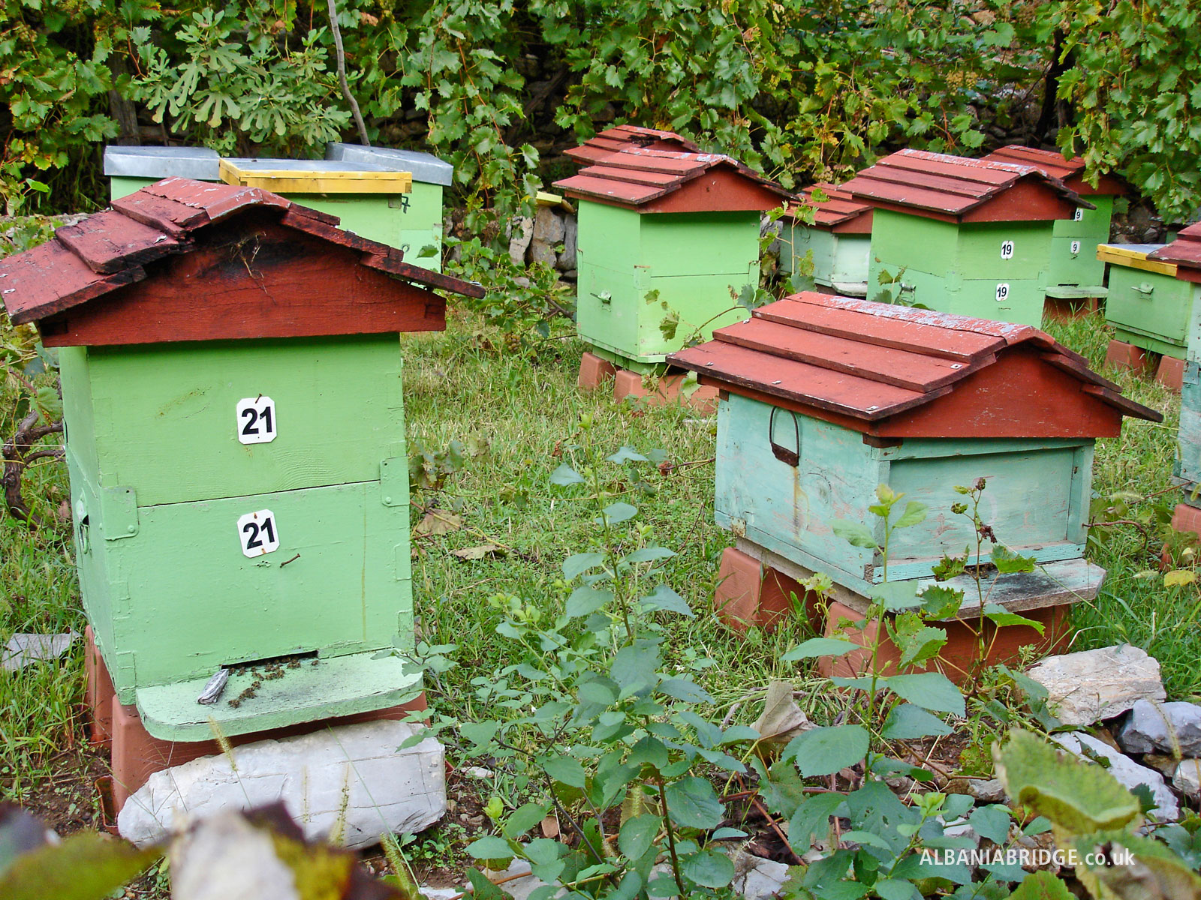
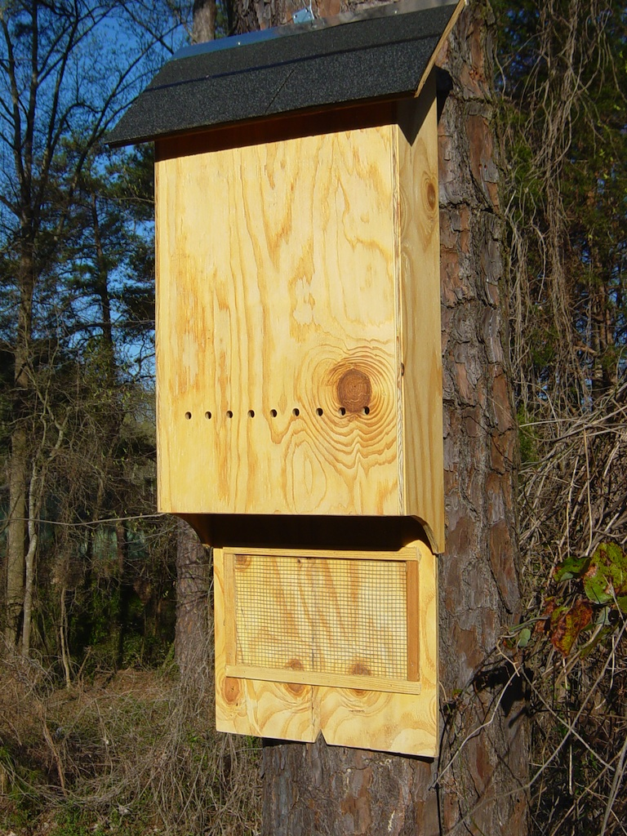
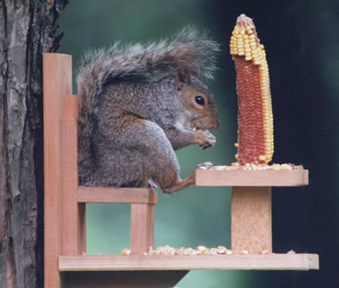
Attracting Wildlife to Your Yard
4. Provide constructed habitat
Bat houses
Bird houses- specific
Mason bee houses
Bee hives
Squirrel chairs

Slide 15
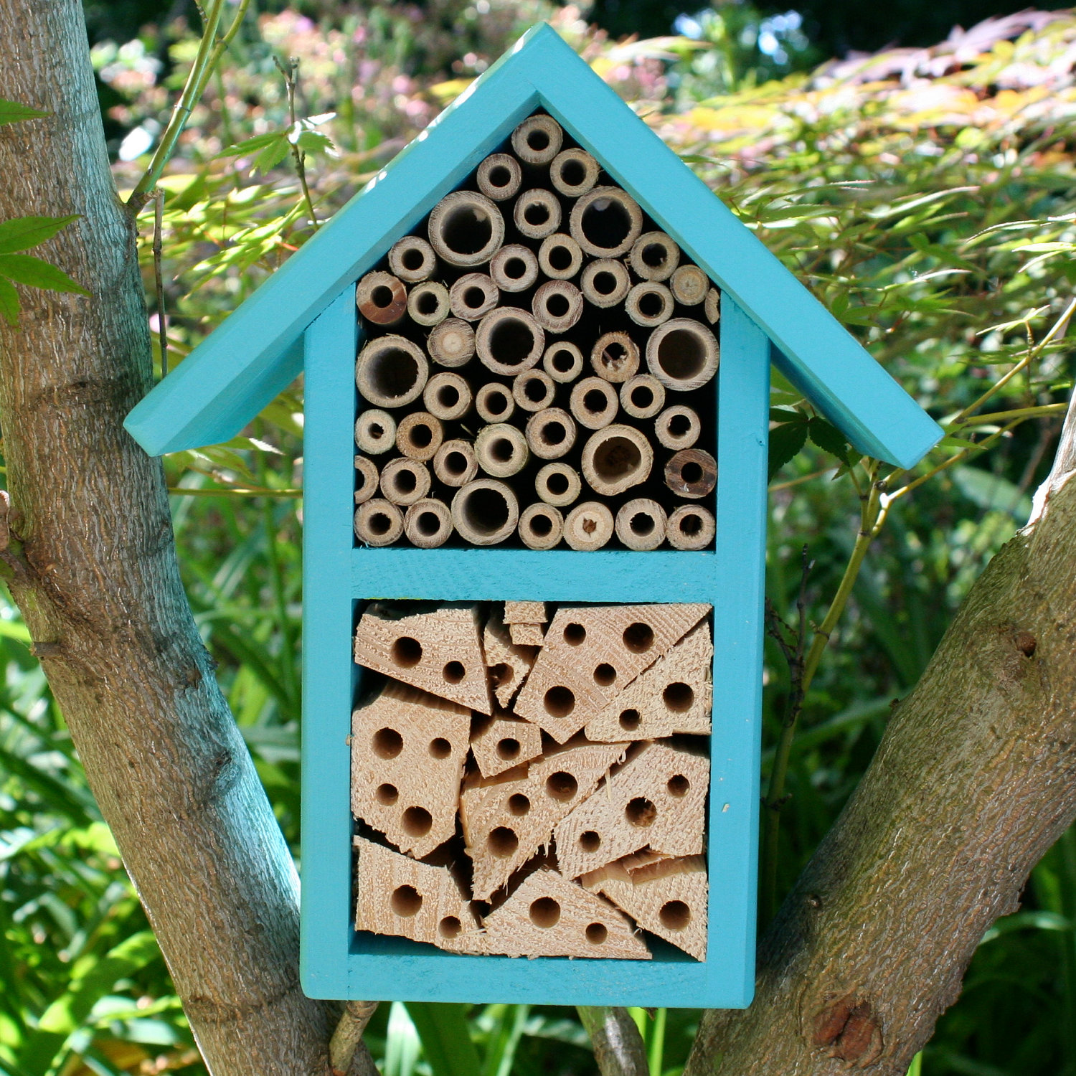
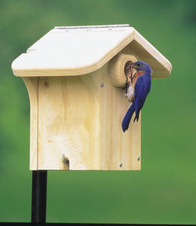
Attracting Wildlife to Your Yard
4. Provide constructed habitat
Bird houses
Mason bee houses

Slide 16
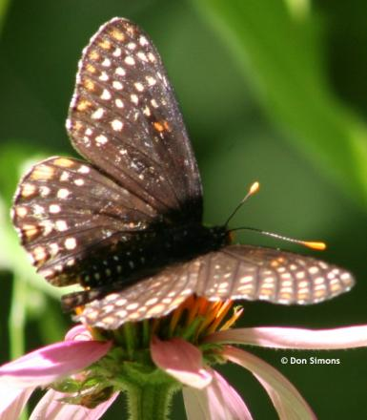
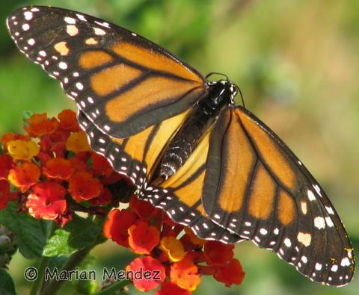
Attracting Butterflies
Use native flowering plants that are red, yellow, orange, pink and purple
Use flowers that are flat topped, clustered or have short flower tubes
Butterfly plantings should be located in full sun from mid morning to mid afternoon
Plant for continuous bloom to keep a steady nectar supply
Do not use insecticides, not even Bt which kills caterpillars
Use flat stones in your garden in the sun to provide a place for butterflies to rest.
Put sand in a flat pan and insert pan into soil in butterfly garden area to provide a place for butterflies to drink water.

Slide 17
Attracting Monarchs
Favored Nectar Plants:
Buckwheat (Eriogonum)
Butterfly Bush (Buddleia)
California Lilac (Ceanothus)
Citrus (Citrus)
Coneflower (Echinacea)
Coreopsis (Coreopsis)
Cosmos (Cosmos)
Daisy (Aster and Chrysanthemum)
Dianthus (Dianthus)
Heliotrope (Heliotropium)
Lantana (Lantana)
Marigold (Tagetes)
Milkweed (Asclepias)
Pincushion Flower (Scabiosa)
Rabbit Brush (Chryssothamnus)
Rock Cress (Arabis)
Salvia (Salvia)
Senecio (Senecio)
Star Clusters (Pentas)
Sweet Alyssum (Lobularia)
Verbena (Verbena)
Wall Flower (Erysimum)
Zinnia (Zinnia)

Slide 18
Attracting Birds
4. Provide constructed habitat
Bird houses
Mason bee houses

Slide 19
Attracting Bees
4. Provide constructed habitat
Bird houses
Mason bee houses

Slide 20
Attracting Turtles, Frogs and Lizards
4. Provide constructed habitat
Bird houses
Mason bee houses

Slide 21
Attracting Hummingbirds
4. Provide constructed habitat
Bird houses
Mason bee houses

Slide 22
Gardening for Kids
Attract butterflies, birds, bees, bats, fox
Plant flowers, herbs, fruits, veggies
Start simply- a few plants, then grow

Slide 23
Ferns
Ferns are great for moist, shady locations
Ferns provide protection for frogs and lizards
They work well in rain gardens
Royal fern will grow in sunnier conditions

Slide 24
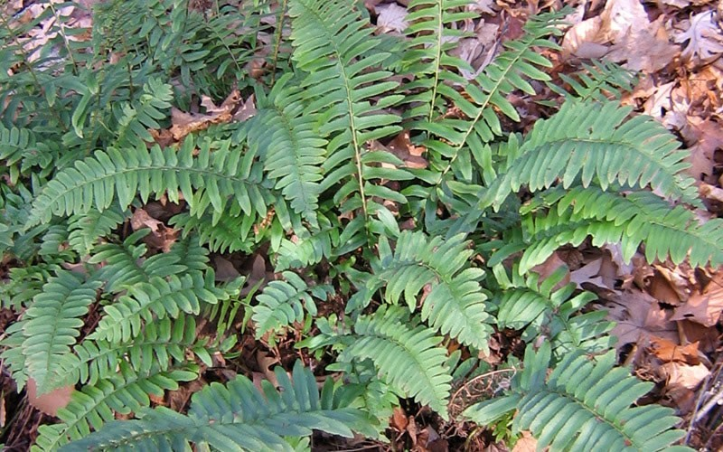
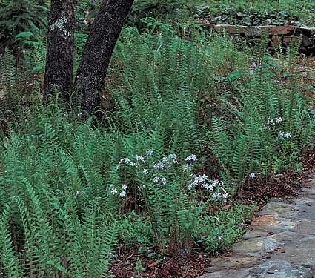
Polystichum acrostichoides
Christmas Fern
Height: 1.00 to 2.00 feet
Spread: 1.00 to 2.00 feet
Sun: Part shade to full shade
Water: Dry to medium
Maintenance: Low
Leaf: Evergreen
Pic
Other: Winter Interest
Tolerate: Rabbit, Deer, Drought, Heavy Shade, Erosion, Dry Soil, Shallow-Rocky

Slide 25
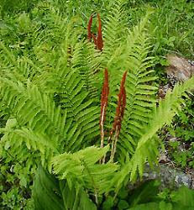
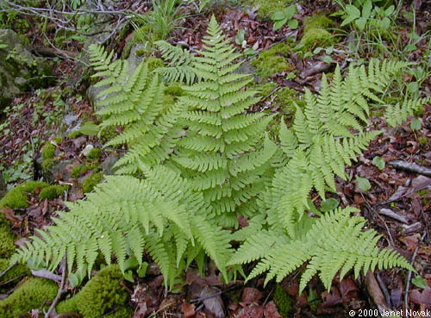
Dryopteris marginalis
Evergreen Wood Fern
Height: 1.50 to 2.00 feet
Spread: 1.50 to 2.00 feet
Sun: Part shade to full shade
Water: Medium
Maintenance: Low
Leaf: Evergreen
Other: Winter Interest
Tolerate: Rabbit, Heavy Shade

Slide 26
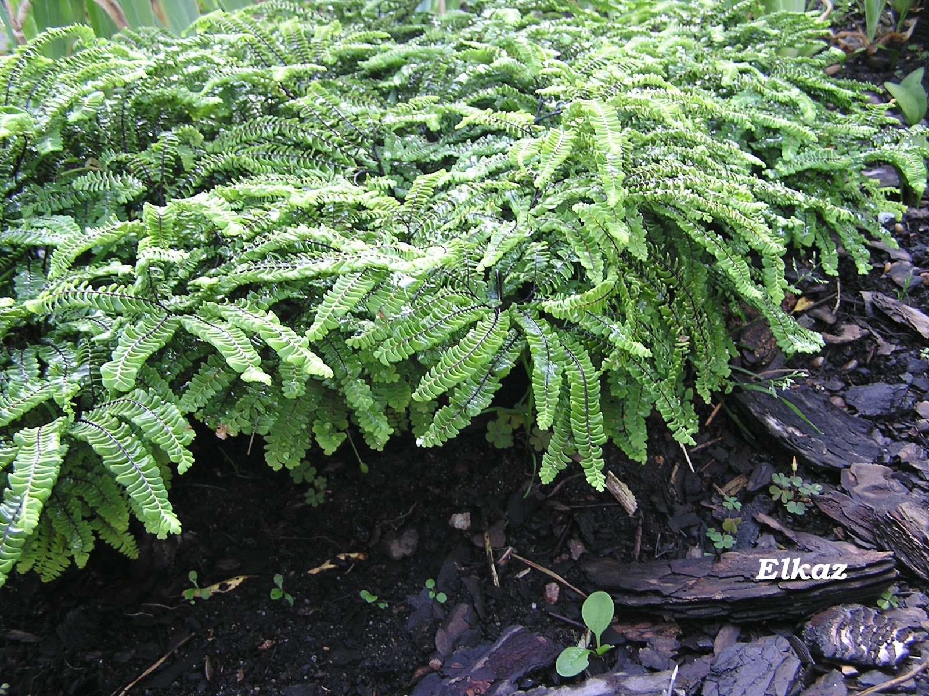
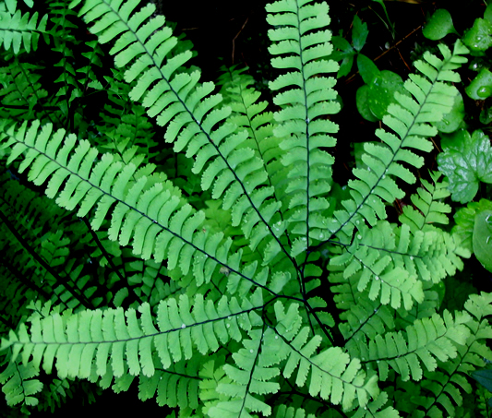
Adiantum pedatum
Maidenhair Fern
Height: 1.00 to 2.50 feet
Spread: 1.00 to 1.50 feet
Sun: Part shade to full shade
Water: Medium
Maintenance: Low
Suggested Use: Naturalize
Tolerate: Heavy Shade
Woodland garden, shaded rock garden, edging
Protection for toads and lizards

Slide 27
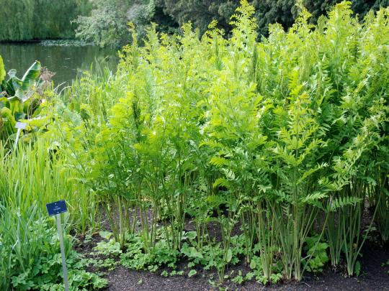
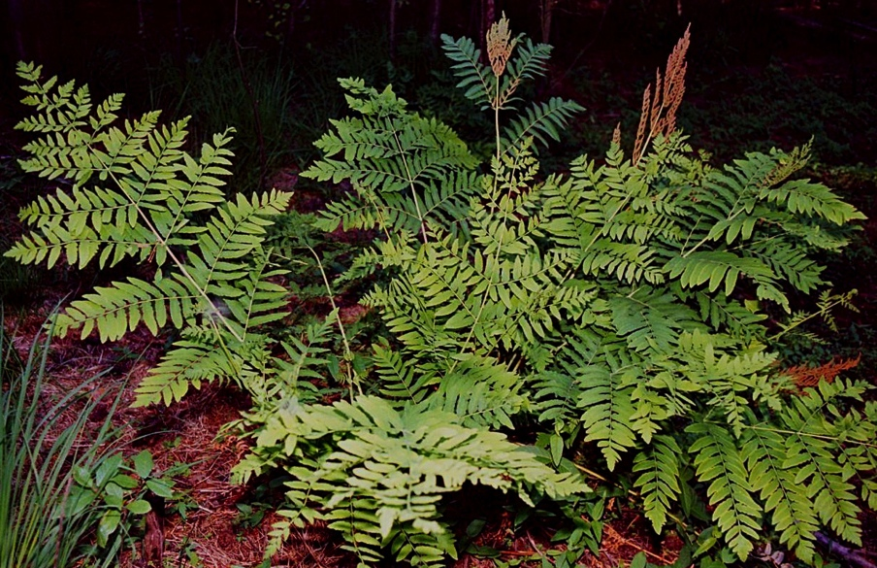
Osmunda regalis --Royal Fern
Height: 2.00 to 3.00 feet
Spread: 2.00 to 3.00 feet
Sun: Part shade to full shade
Water: Medium to wet
Maintenance: Low
Ponds, Streams, Bogs, Water garden, Rain Garden
Tolerate: Rabbit, Heavy Shade, Wet Soil
Woodland garden, shaded rock garden, near water
Protection for toads and lizards

Slide 28
Grasses
Grasses tend to be most beneficial for birds for seed and nesting
Replace invasive grasses that grow vigorously and can be really hard to control or divide
Liriope is a notable ‘grass’ that can be replaced with Carex pennsylvanica

Slide 29
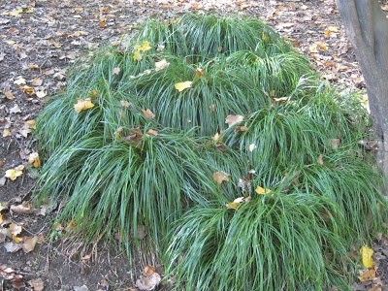
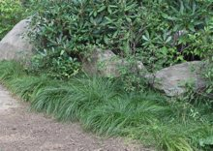
Carex pennsylvanica
Pennsylvania Sedge
Height: 0.50 to 1.00 feet
Spread: 0.50 to 1.00 feet
Bloom Time: May
Bloom Description: Greenish
Sun: Part shade to full shade
Water: Dry to medium
Maintenance: Low
Works well as a groundcover and its a great replacement for Liriope spp
Tolerates wet soil and deep shade
Great to plant in areas that are eroding

Slide 30
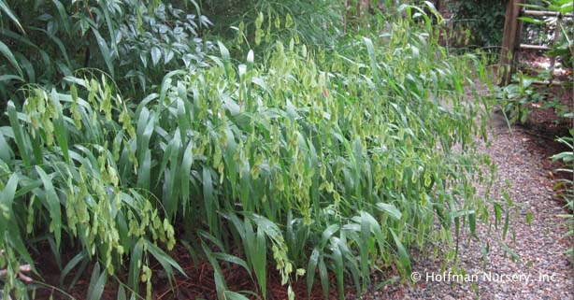
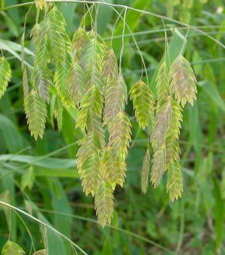
Chasmanthium latifolium
Northern Sea Oats
Height: 2.00 to 5.00 feet
Spread: 1.00 to 2.50 feet
Bloom Time: August to September
Bloom Description: Green
Sun: Full sun to part shade
Water: Medium to wet
Maintenance: Low
Flower: Showy, Good Cut, Good Dried
Leaf: Good Fall
Other: Winter Interest
Tolerate: Black Walnut
Tends to spread- plant in a place where it has room to do that!

Slide 31
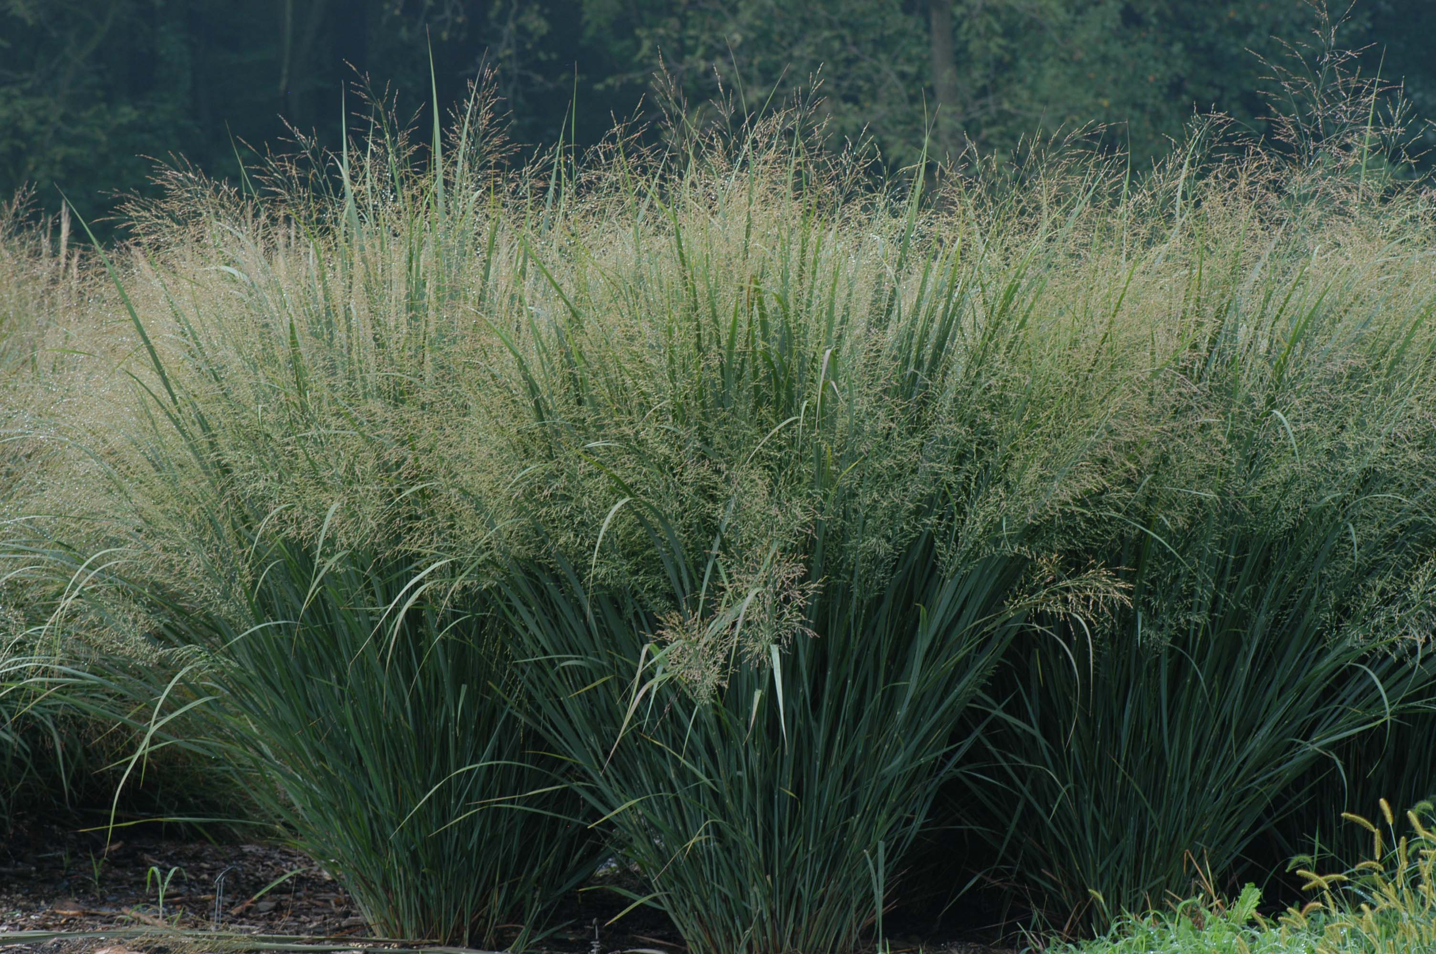
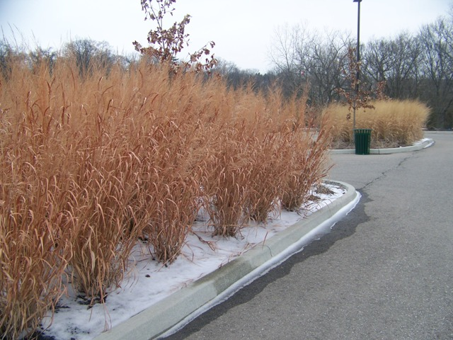
Panicum virgatum---Switchgrass
Height: 3.00 to 6.00 feet
Spread: 2.00 to 3.00 feet
Bloom Time: July to February
Bloom Description: Pink-tinged
Sun: Full sun to part shade
Water: Medium to wet
Maintenance: Low
Living privacy border, rain garden
Flower: Showy, Good Cut, Good Dried
Nice fall foliage
Attracts butterflies and birds
Other: Winter Interest
Tolerate of Drought, Erosion, Dry Soil, Wet Soil, Black Walnut, Air Pollution

Slide 32
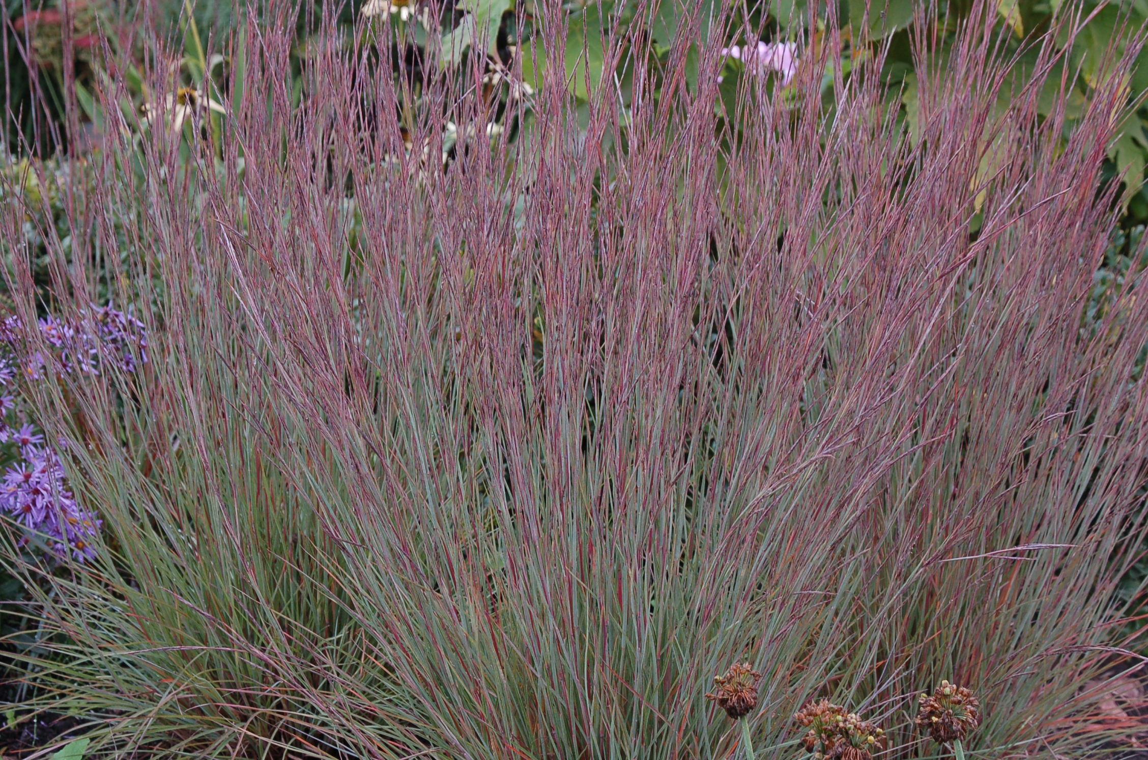
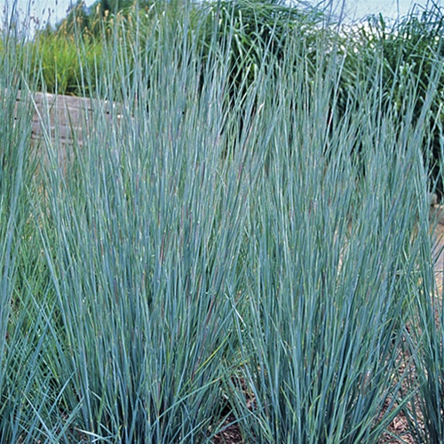
Schizachyrium scoparium ---Little Bluestem
Height: 2.00 to 4.00 feet
Spread: 1.50 to 2.00 feet
Bloom Time: August to February
Bloom Description: Purplish bronze
Sun: Full sun
Water: Dry to medium
Low maintenance
Nice fall foliage
Good for winter interest, privacy border
Tolerates Deer, Drought, Erosion, Dry Soil, Shallow-Rocky Soil, Black Walnut, Air Pollution

Slide 33
Groundcovers
Groundcovers are low to medium in height and can be used to fill in bare spots in the garden
They provide cover for birds and insects and food for pollinators
Some invasive ground covers to take out would be English ivy, kudzu, Japanese honeysuckle

Slide 34
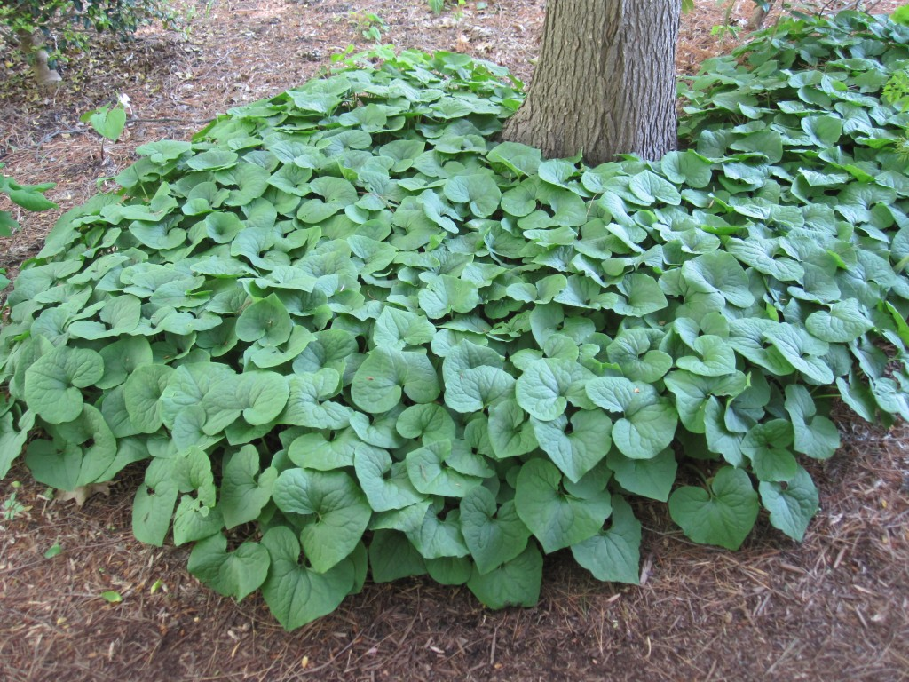
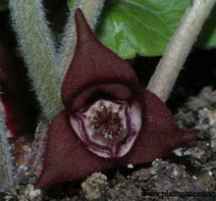
Asarum canadense
Wild Ginger
1-1.5’ Height and Spread
April to May
Part shade to full shade
Water: Medium to wet
Low maintenance
Use as a ground cover, in a woodland garden, rain garden
The flower is usually hidden by foliage in spring and is a nice maroon color.
Tolerates deer, heavy shade, erosion, wet soil

Slide 35
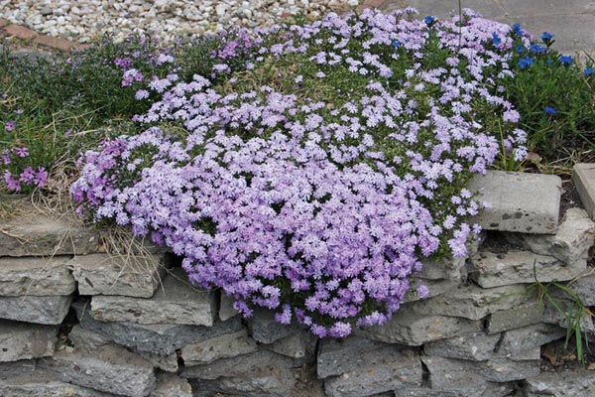
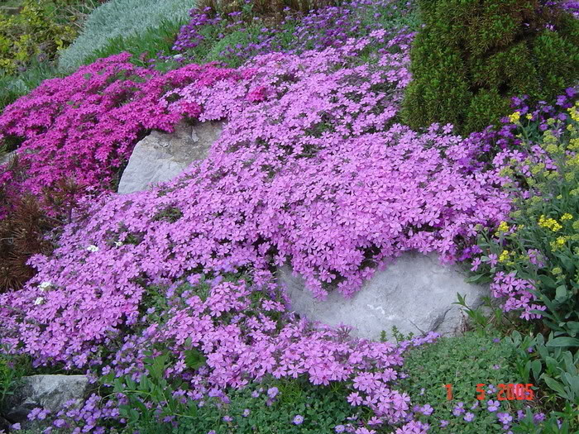
Phlox subulata
Moss Pinks
Height: 0.25 to 0.50 feet
Spread: 1.00 to 2.00 feet
Blooms in March to May
Many varieties with various colors-Red-purple to violet-purple to pink to white
Full sun
Moist soil
Use as a ground cover, rock garden, sunny slope
Attracts butterflies
Tolerates deer, drought, erosion and air pollution

Slide 36
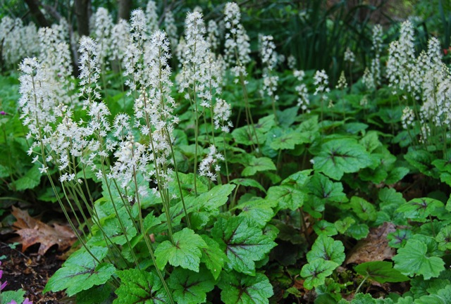
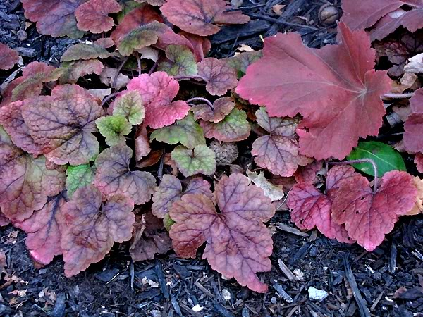
Tiarella cordifolia 'Brandywine'
Brandywine tiarella
1-2 ft wide and .5-1ft tall
White or pink flowers bloom in May
Part shade to full shade
Moist soil
Low maintenance
Use as a ground cover, rain garden, woodland garden
Attracts bees and butterflies
Nice fall foliage
Tolerates rabbit and deer

Slide 37
Where to Find Native Plants
2017 Native Plant Sales
Robinson Nature Center Native Plant Palooza May 7th, 12-4pm
How to Design Your Native Plant Garden- a class taught by Lauren through parks and rec. April or early May
Howard County Community College- Greenfest plant sale April 22nd, 10-4pm
Banneker Museum in Catonsville April 29th, 11am-3pm
BayWise Garden Tour Native Plant Sale- straight species, Fall 2017
Lauren’s Garden Service Native Plant Online Shop
Join Our Email List to get updated information on events and plant sales!

Slide 38
Need Help Planning and Planting
We have extensive experience in the Howard County area with designing and planting new landscapes, patios, walkways, firepits, ponds, outdoor living areas, and the use of native plants and eco friendly gardening practices
We have monthly weeding programs and can service your garden for anything you may need- weeding, pruning, edging, mulching, garden recovery, garden renovation, fertilizing, new plantings, transplantings and much more!
Call us today for a free estimate or request a free estimate here.

Slide 39
Citations
http://www.wildflower.org
http://www.abnativeplants.com
http://www.missouribotanicalgarden.org
http://www.butterfliesandmoths.org/
http://www.nwf.org/How-to-Help/Garden-for-Wildlife/Gardening-Tips/How-to-Attract-Butterflies-to-Your-Garden.aspx

Slide 40
Favorite Books on Native Plants
Resources
Doug Tallemy’s Bringing Nature Home
Frank Porter’s Back To Eden
Barbara Ellis Chesapeake Gardening and Landscaping
Carol Gracie Spring Wildflowers
Planting in a Post Wild World- Claudia West and Thomas Rainier
Native Plants for Wildlife Habitat and Conservation Landscaping- DNR book
Howard County Cleanscapes reimbursement program for rain gardens, rain barrels, pervious paver installs, conservation landscapes and more
Local Groups That Promote Natives:
Watershed Stewards
Master Gardeners
Baywise Garden Tour

